Slide 1
Anaylsis ->Design explained with artichectural Layers
Logical architecture:
Large scale organization of the software classes into packages

Slide 2
the relation between logical architecture and UML package diagram
A UML package diagram provides a way to group elements. A UML package can group classes, other packages, use cases, and so on. UML package diagrams are often used to illustrate the logical architecture of a system the layers, subsystems, packages .A layer can be modeled as a UML package; for example, the UI layer modeled as a package named UI.

Slide 3
Layered Architectures
Typical layers in an OO system:
  User Interface
  Application Logic and Domain Objects
  Technical Services
    Application-independent, reusable across systems.
Relationships between layers:
  Strict layered architecture: a layer only calls upon services of the layer directly below it.
Relaxed layered architecture: a higher layer calls upon several lower layers

Slide 4
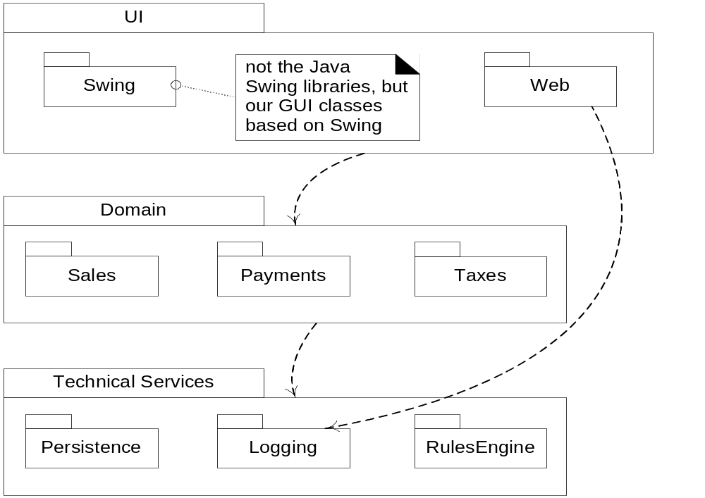

Slide 5
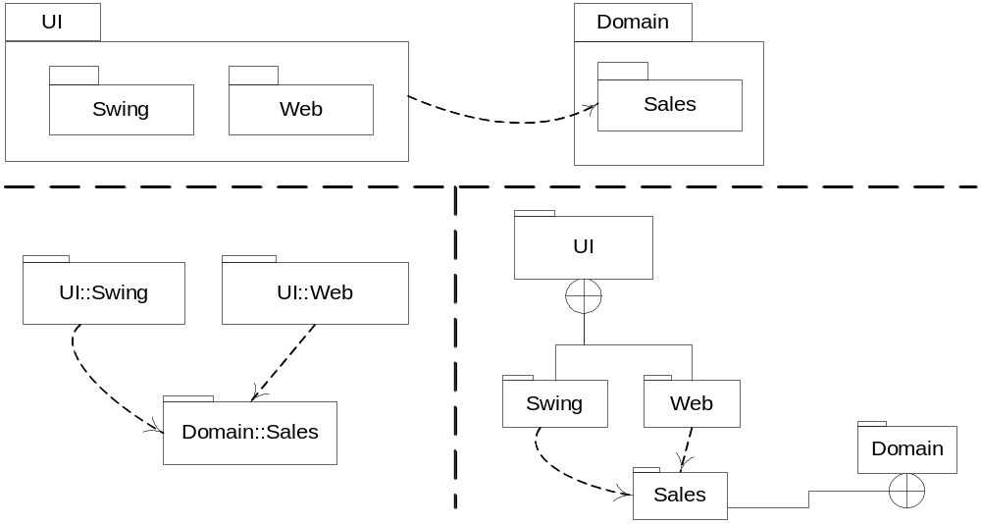

Slide 6
Design with Layers
Organize the large-scale logical structure of a system into discrete layers of distinct, related responsibilities.
  Cohesive separation of concerns.
  Lower layers are general services.
  Higher layers are more application-specific.
Collaboration and coupling is from higher to lower layers.
  Lower-to-higher layer coupling is avoided.

Slide 7
Benefits of a Layered Architecture
Separation of concerns:
E.g., UI objects should not do application logic (a window object should not calculate taxes) nor should a domain layer object create windows or capture mouse events.
  Reduced coupling and dependencies.
  Improved cohesion.
  Increased potential for reuse.
  Increased clarity.

Slide 8
Related complexity is encapsulated and decomposable.
Some layers can be replaced with new implementations.
Lower layers contain reusable functions.
Some layers can be distributed.
  Especially Domain and Technical Services.
Development by teams is aided by logical segmentation.

Slide 9
Designing the Domain Layer
Create software objects with names and information similar to the real-world domain.
Assign application logic responsibilities to these domain objects.
  E.g., a Sale object is able to calculate its total.
The application logic layer is more accurately called a domain layer when designed this way.

Slide 10


Slide 11
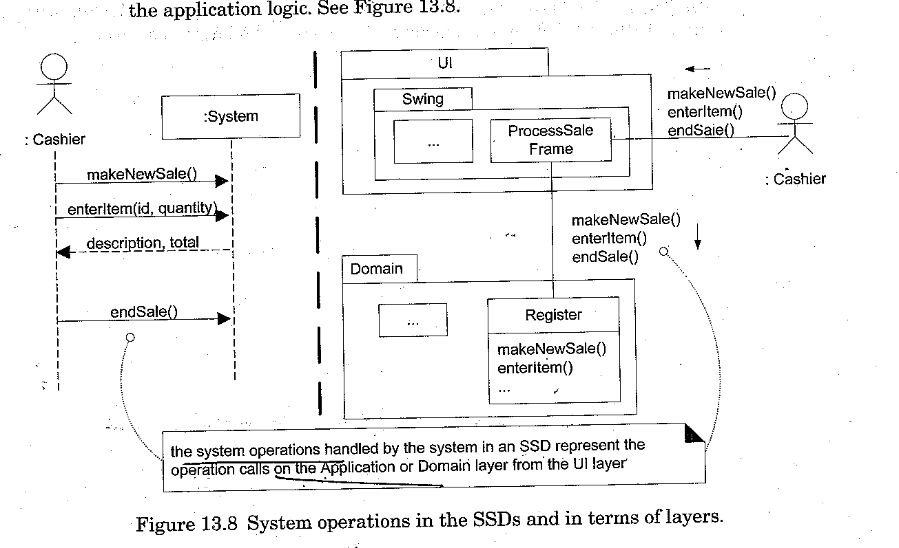
SSD and Layers

Slide 12
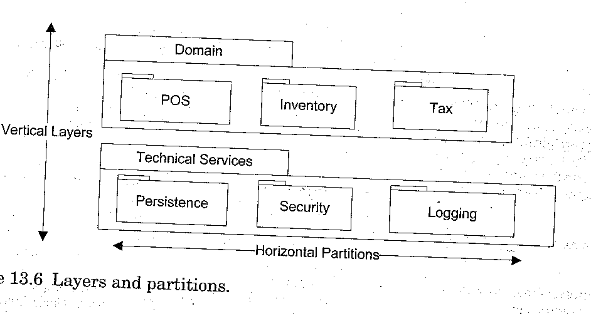

Slide 13
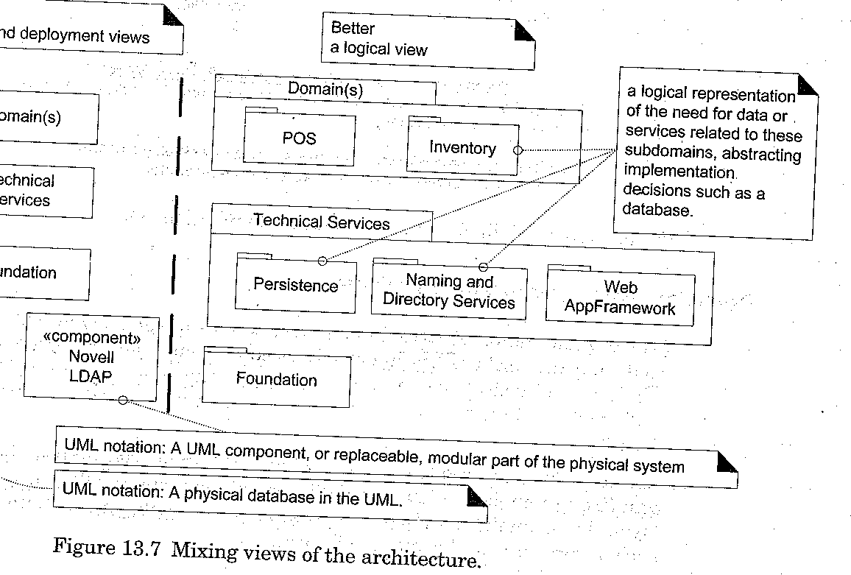

Slide 14
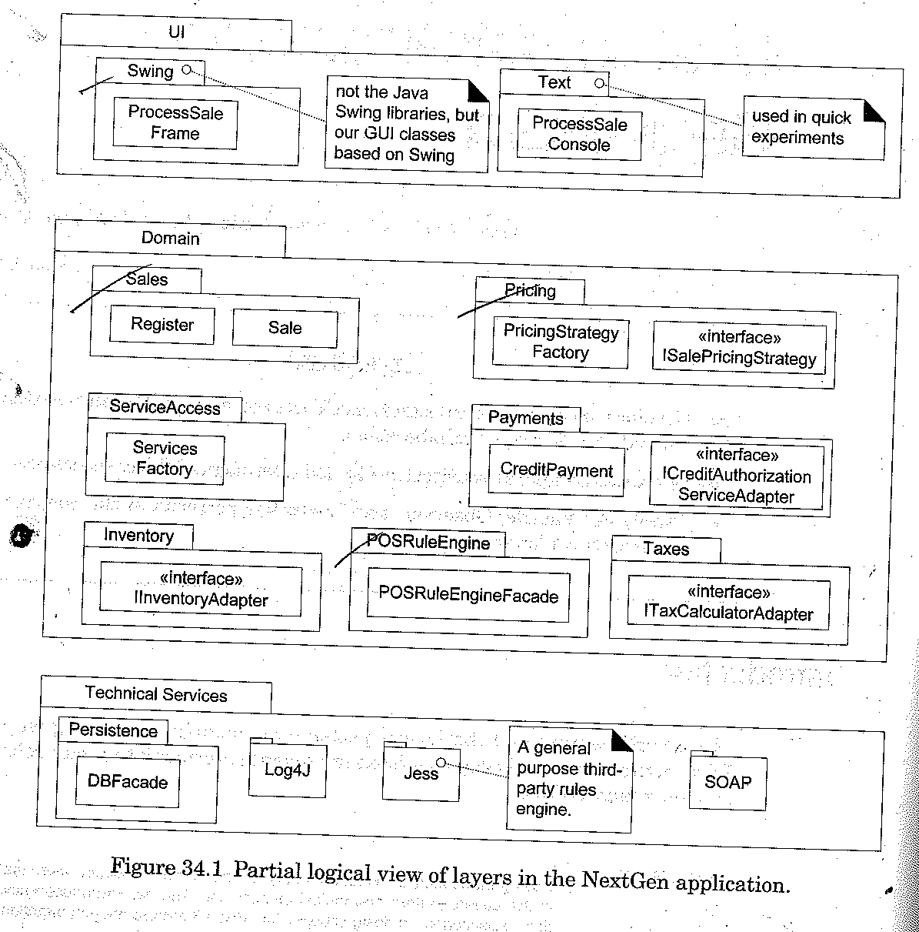

Slide 15
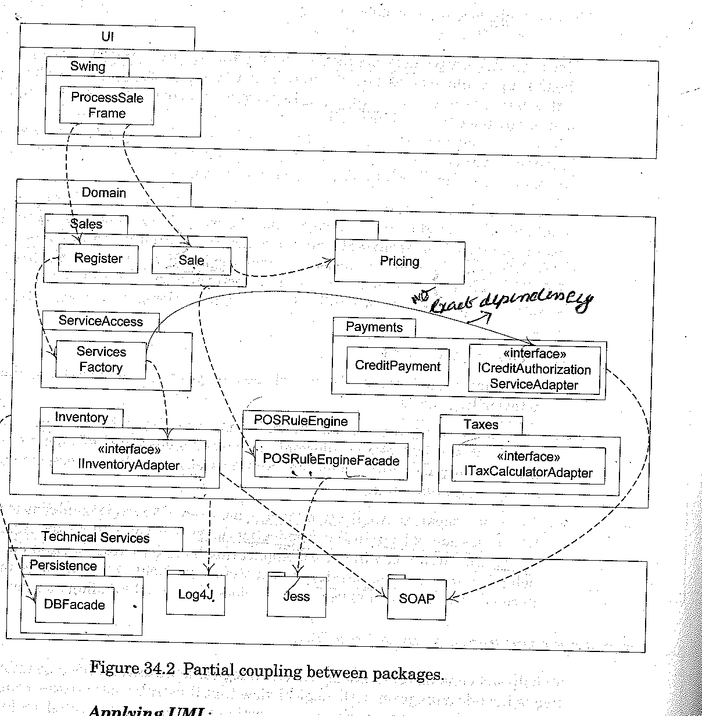
Inter-layer and Inter-Package Coupling

Slide 16
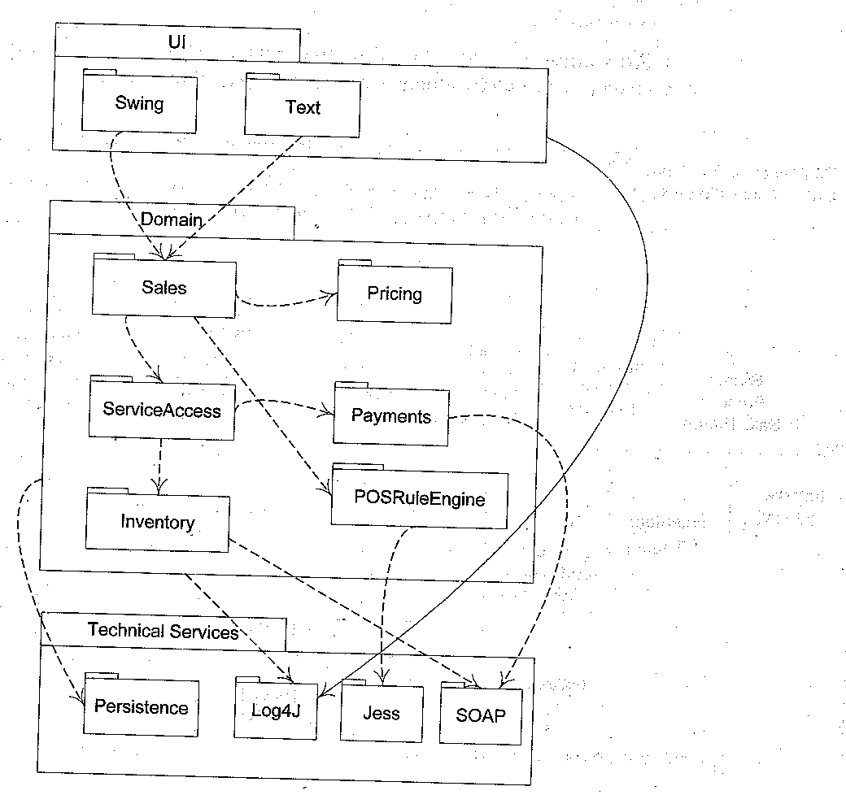
Hiding specific types

Slide 17
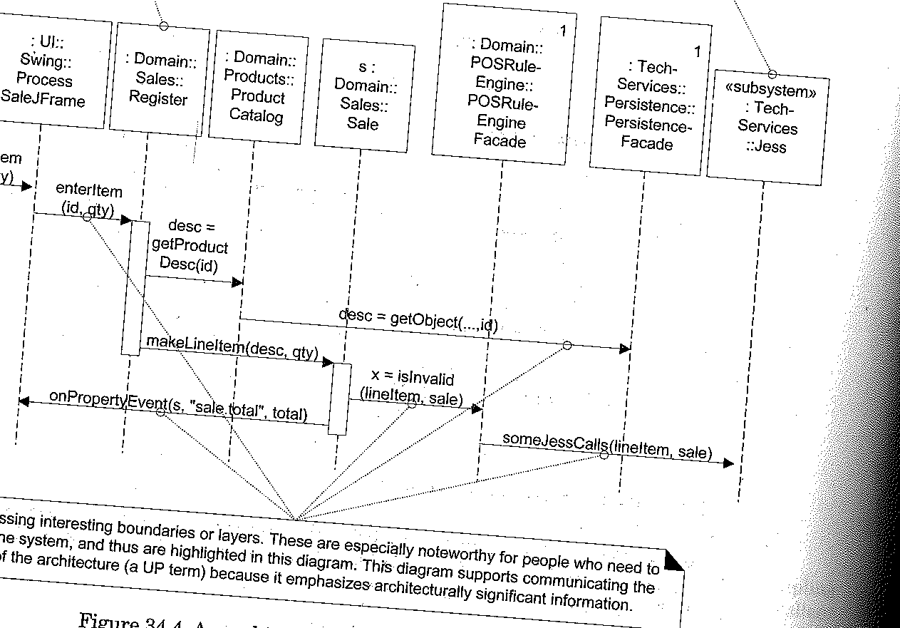
Inter-layer and Inter-package INTERACTION SCENARIOS

Slide 18
Starts from Cashier
Package diagram is static
To show dynamic view we can use Interaction diagram
1 represents singleton class
Path name expression
  <packagename>::<typename>

Slide 19
subsystem
Is a discrete entity that has behavior and interface.
To access subsystem façade is needed.
Client interact with façade(services are declared)
Eg persistence –persistence façade
It is a mediator .it does not do the work.

Slide 20
Collaboration with layers pattern(logical architecture)
Two design decisions at an architectural level
  What are the big parts?(Architectural layers pattern)
  How are they connected?(micro-architectural design patterns like façade, observer and controller)

Slide 21
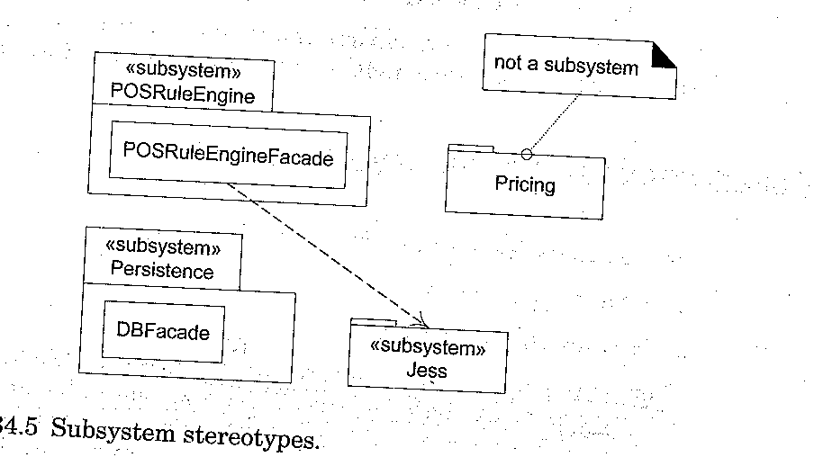

Slide 22
Façade(GOFpattern)
Public façade object defines the services for the subsystems and client collaborate with the façade .
Façade does not normally do its own work rather it is consolidator or mediator to the underlying subsystem object which do the work

Slide 23
Session facade
To handle many use cases and system operation ,we can introduce session facades for different use cases in the application layer.
Session facades maintains session state for the operation of a use case where each session instance represents a session with one client.

Slide 24
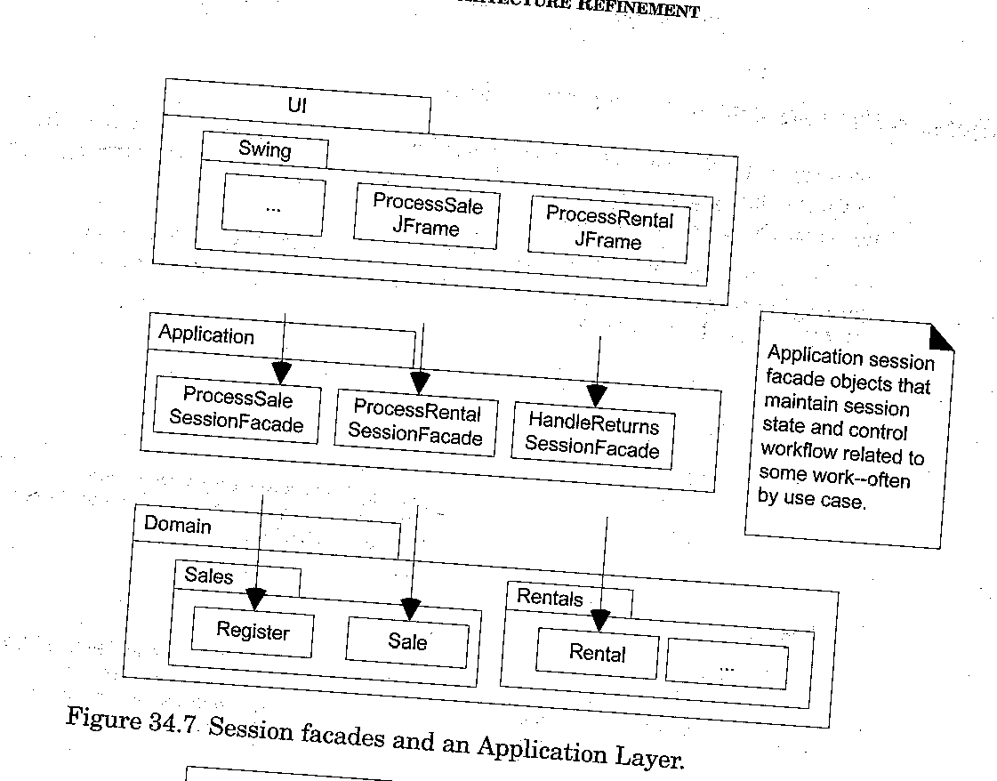

Slide 25
GRASP Controller pattern
It describes common choices in client side handlers for system operation request emitting from the UI layer

Slide 26
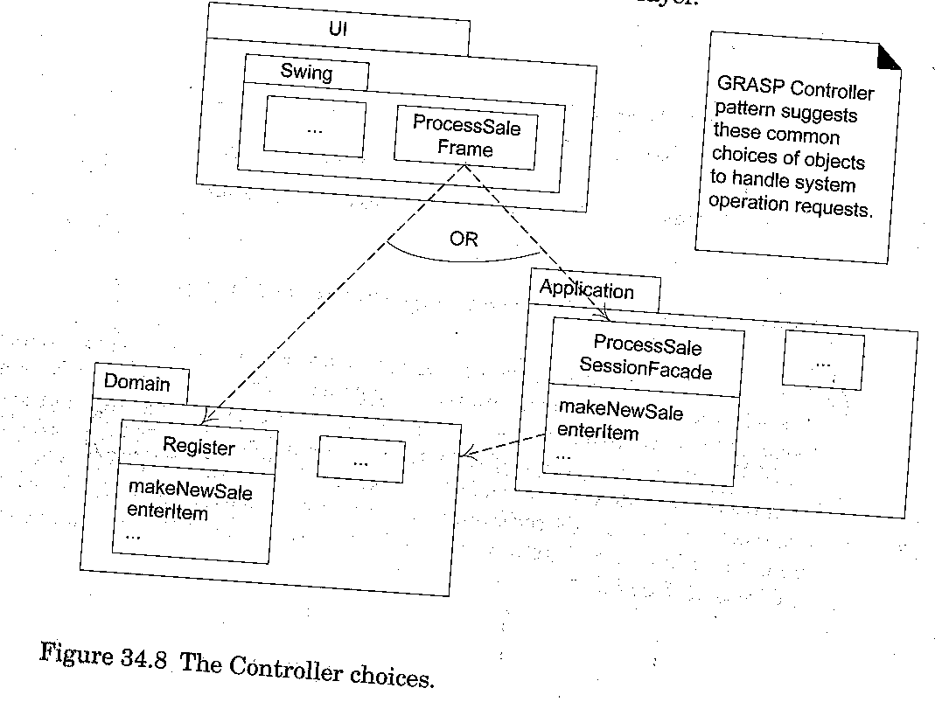

Slide 27
Façade pattern –downward collaboration (from a higher to a lower layer).
or for access to services in another subsystem of the same layer

Slide 28
UPWARD COLLABORATION with OBSERVER
When the lower application or domain layer needs to communicate upward with the UI layer –observer pattern
UI objects in the higher UI layer implement an interface such as alarm listener,propertylisteners.
Subscribers or listeners to events coming from objects in the lower layers.
Lower layer objects are directly sending messages to the upper layer UI objects.

Slide 30
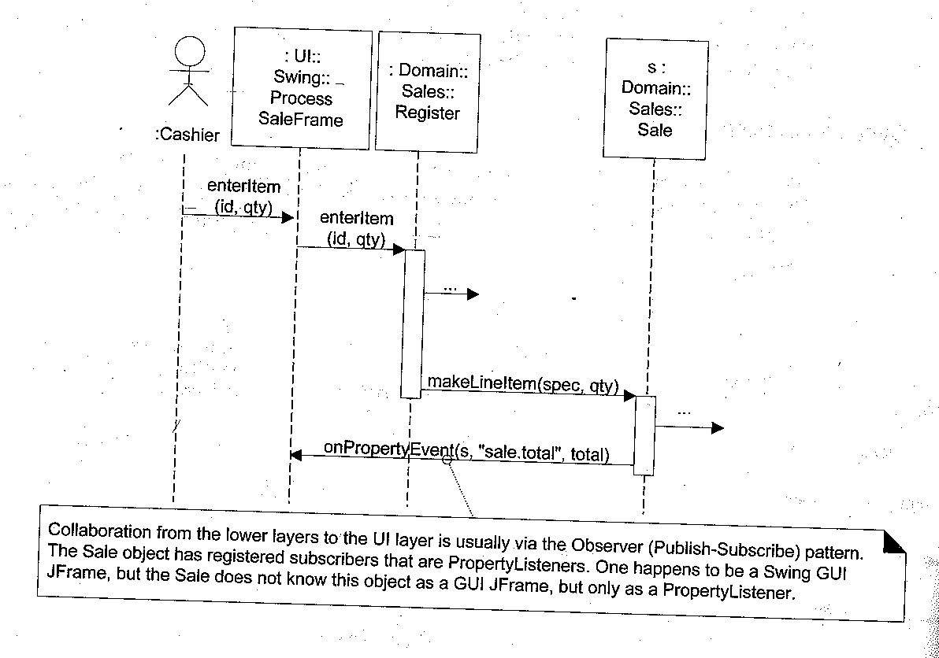

Slide 31
Model –View separation Principle
Model(domain) objects should not have direct knowledge of view(UI) objects

Slide 32
Model –View separation PRINCIPLE
Do not connect or couple non UI objects directly to UI objects
    Non UI(windowing) objects may be reused or attached with other interface
Do not put application logic in the UI object methods.
  UI –initialize UI elements, receive UI events and delegate requests to domain objects or UI objects

Slide 33
Windows obtain information to display
Polling or pull from above
Monitoring applications.
Simulations
Push from below
  Observer pattern
  UI facade object

Slide 34
MODEL-DOMAIN LAYER of objects
VIEW –UI objects Eg.Windows,web pages,applets and reports.

